Slide 1
Facial Retargeting
GCT 522 Final Project
20183151 Chaelin Kim

Slide 2
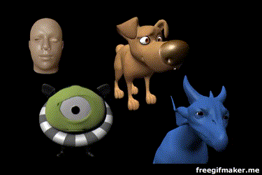
Goals
Facial motion retargeting
Retargeting the facial animation of source character to target character
Source
Targets
Notes:
Among the two projects, I chose the Facial Retargeting project.
The goal of this project is to retarget the facial animation of the source character to the target character

Slide 3
Goals
Facial motion retargeting
Retargeting the facial animation of source character to target character
Characteristic facial retargeting [Song et al. 2011]
Data-driven method
Range of expression(ROE) pairs
Emotional sequence pairs
Retargeting
Linear mapping → RBF
Non-linear mapping → kCCA
Source
Targets
Notes:
For that, I have implemented some parts of the paper “Characteristic facial retargeting”.
In this project,

Slide 4
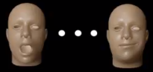
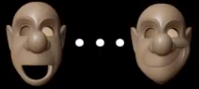
Methods
Range of expression pairs
Source and target facial expressions
Manually mapping
Source
ROE
Target
ROE
Notes:
For retargeting, they used the pairs of semantically identical face expressions between the source and target models.
This process is done manually and source and target ROE size must be same.

Slide 5
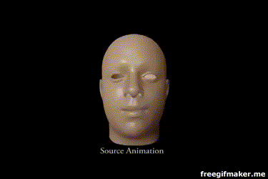
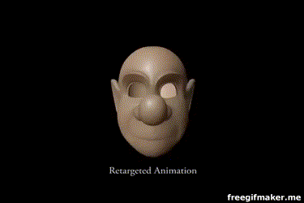
Methods
Range of expression pairs
Source and target facial expressions
Manually mapping
Source
Animation
Source
ROE
Target
Animation
Target
ROE
Notes:
With these ROE data and source animation data, the target animation is made.

Slide 6
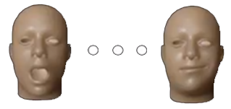
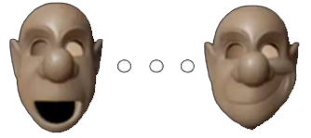
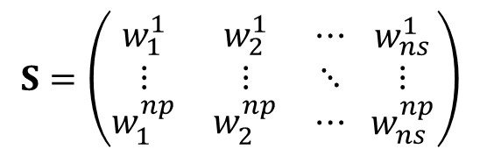
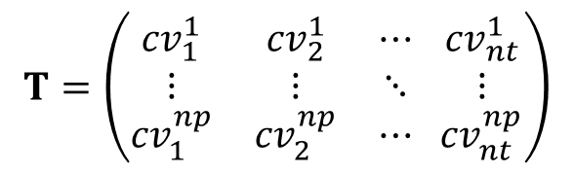
Methods
ROE
Retargeting
ROE
$$S=\left(\begin{matrix}w_{1}^{1} & w_{2}^{1} & ⋯ \\ ⋮ & ⋮ & ⋱ \\ w_{1}^{np} & w_{2}^{np} & ⋯\end{matrix} \begin{matrix}w_{ns}^{1} \\ ⋮ \\ w_{ns}^{np}\end{matrix}\right)$$
$$T=\left(\begin{matrix}{cv}_{1}^{1} & {cv}_{2}^{1} & ⋯ \\ ⋮ & ⋮ & ⋱ \\ {cv}_{1}^{np} & {cv}_{2}^{np} & ⋯\end{matrix} \begin{matrix}{cv}_{nt}^{1} \\ ⋮ \\ {cv}_{nt}^{np}\end{matrix}\right)$$
Blend weights
Control vectors
RBF (Radial Basis Function)
Notes:
In training the model, they use the RBF method to learn the best weight values between source and target data pairs.

Slide 7

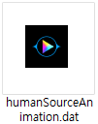
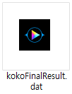

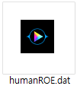



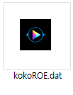
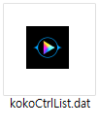
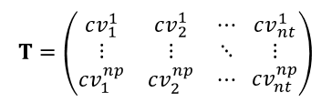
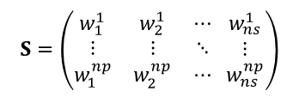
Implement
FRRBlendExport
$$S=\left(\begin{matrix}w_{1}^{1} & w_{2}^{1} & ⋯ \\ ⋮ & ⋮ & ⋱ \\ w_{1}^{np} & w_{2}^{np} & ⋯\end{matrix} \begin{matrix}w_{ns}^{1} \\ ⋮ \\ w_{ns}^{np}\end{matrix}\right)$$
$$T=\left(\begin{matrix}{cv}_{1}^{1} & {cv}_{2}^{1} & ⋯ \\ ⋮ & ⋮ & ⋱ \\ {cv}_{1}^{np} & {cv}_{2}^{np} & ⋯\end{matrix} \begin{matrix}{cv}_{nt}^{1} \\ ⋮ \\ {cv}_{nt}^{np}\end{matrix}\right)$$
FRRTraining
FRRCVExport
FRRCVImport
Notes:
The implementation consists of five processes.

Slide 8
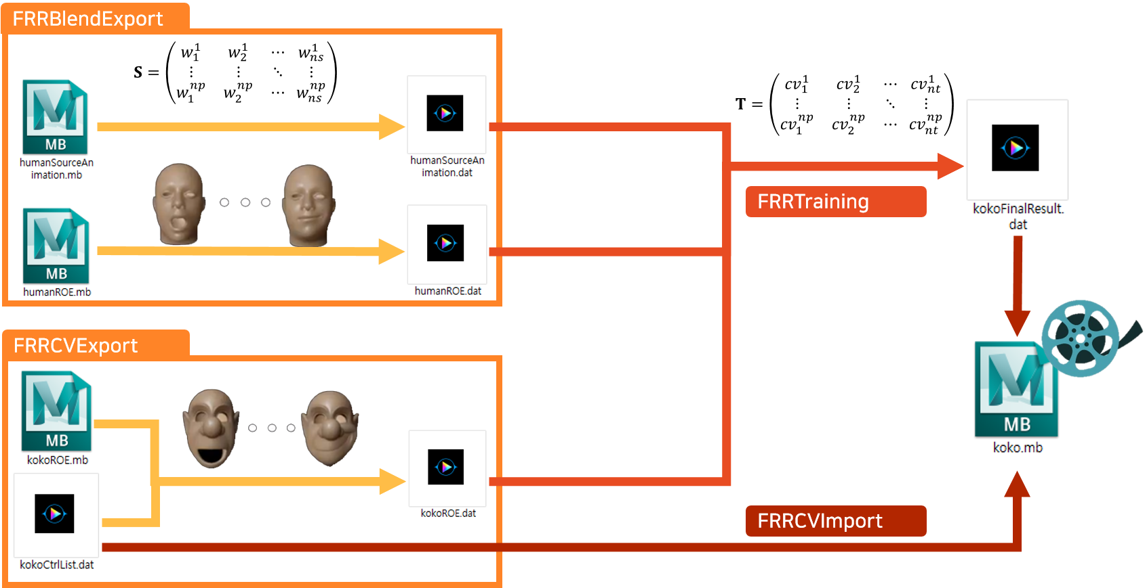
Implement
FRRBlendExport
$$S=\left(\begin{matrix}w_{1}^{1} & w_{2}^{1} & ⋯ \\ ⋮ & ⋮ & ⋱ \\ w_{1}^{np} & w_{2}^{np} & ⋯\end{matrix} \begin{matrix}w_{ns}^{1} \\ ⋮ \\ w_{ns}^{np}\end{matrix}\right)$$
Notes:
First, in FRRBlendExport and FRRCVExport, source animation data and source ROE data are generated.
Get blendshape weights at each frames and write down each weight value on the source animation file
Exporting source ROE is same as the previous process

Slide 9
Implement
FRRCVExport
Notes:
In target character, the ROE

Slide 10
Implement
$$T=\left(\begin{matrix}{cv}_{1}^{1} & {cv}_{2}^{1} & ⋯ \\ ⋮ & ⋮ & ⋱ \\ {cv}_{1}^{np} & {cv}_{2}^{np} & ⋯\end{matrix} \begin{matrix}{cv}_{nt}^{1} \\ ⋮ \\ {cv}_{nt}^{np}\end{matrix}\right)$$
FRRTraining
Notes:
The implementation consists of five processes.
In FRRBlendExport and FRRCVExport, required data are generated.
Then with these data, the RBF network is trained and export the final result matrix after RBF interpolation.
In the last, using final result data and setting the keyframe, the target animation is made.

Slide 11
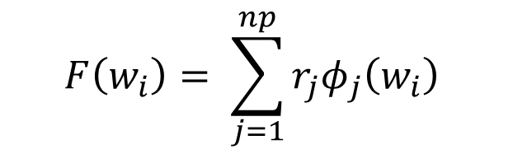
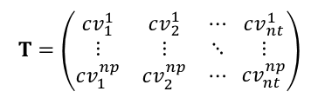
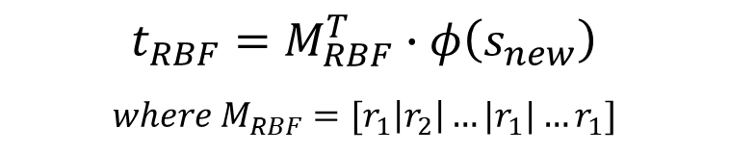
Implement
Export target animation
To make the facial motions of target
Run RBF interpolation
Train the model with source ROE and target ROE → weight matrix
Interpolate source Animation with weight matrix → result matrix for target animation
$$F\left(w_{i}\right)= \sum_{j=1}^{np}{r_{j}φ_{j}\left(w_{i}\right) }$$
$$t_{RBF}=M_{RBF}^{T}∙φ\left(s_{new}\right)$$
$$where M_{RBF}=[r_{1}\left|r_{2}\right|…|r_{1}|…r_{1}]$$
$$T=\left(\begin{matrix}{cv}_{1}^{1} & {cv}_{2}^{1} & ⋯ \\ ⋮ & ⋮ & ⋱ \\ {cv}_{1}^{np} & {cv}_{2}^{np} & ⋯\end{matrix} \begin{matrix}{cv}_{nt}^{1} \\ ⋮ \\ {cv}_{nt}^{np}\end{matrix}\right)$$
FRRTraining
Notes:
Using the source ROE data, build the basis matrix and invert it.
Then dot product of inverseBasis matrix and target ROE data is performed and put it into the weight matrix.
Dot product of source animation data and weight matrix
In this paper, the RBF equation is like this.
They used the hardy multi-quadrics for basis function like the right side equation.
This network is trained np times with source weight values, and target control vector values.

Slide 12
Implement
FRRCVImport
Notes:
The implementation consists of five processes.
In FRRBlendExport and FRRCVExport, required data are generated.
Then with these data, the RBF network is trained and export the final result matrix after RBF interpolation.
In the last, using final result data and setting the keyframe, the target animation is made.

Slide 13
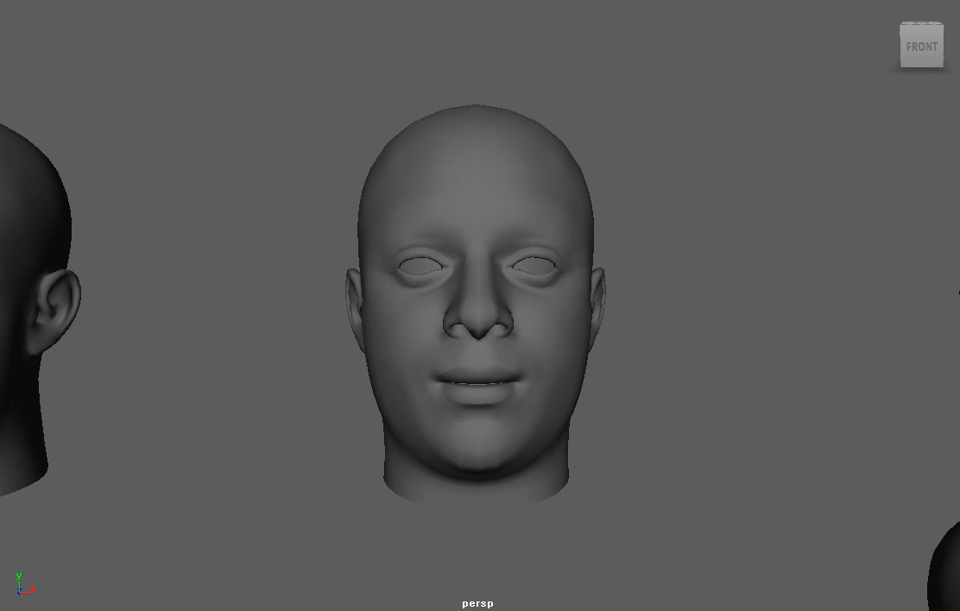
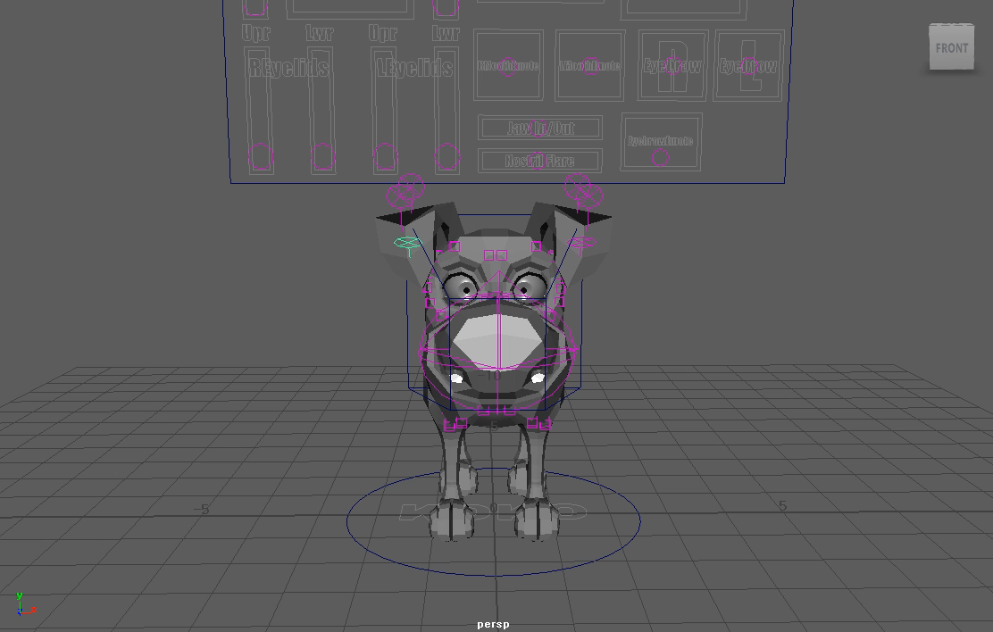
Results
Retargeting to “Koko”
Human (Source)
Koko (Target)
Notes:
Let’s see the results.
This slide shows the Koko’s result animation from the human animation.

Slide 14
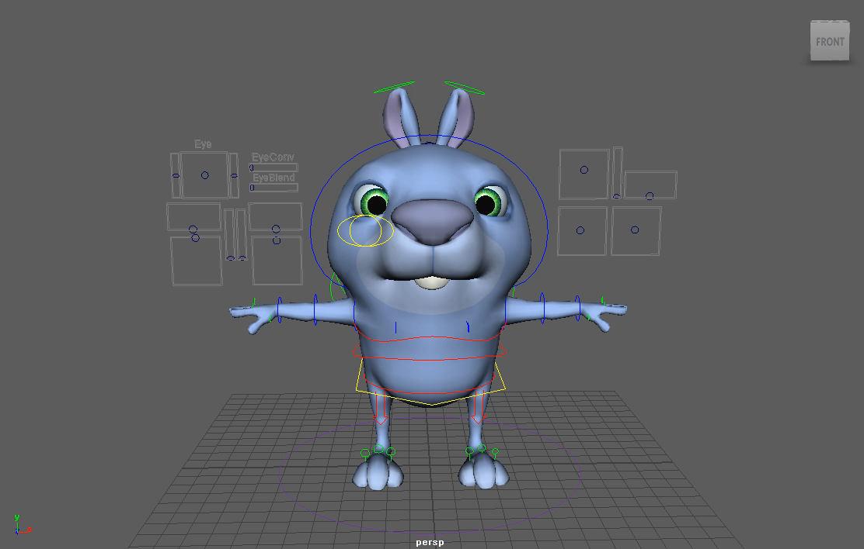
Results
Retargeting to “Squirrely”
Human (Source)
Squirrely (Target)
Notes:
Also, I apply the human animation to another character squirrely.

Slide 15
Results
Comparison
Human (Source)
Koko (Target)
Squirrely (Target)
Notes:
This is the

Slide 16
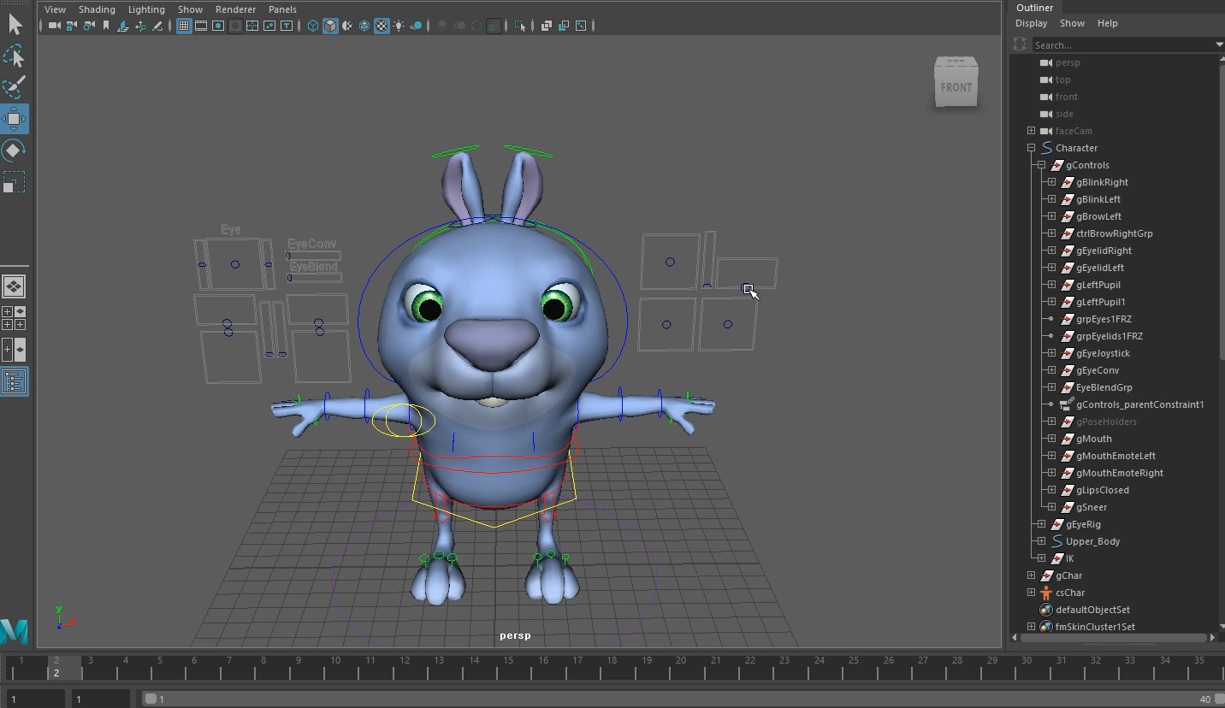
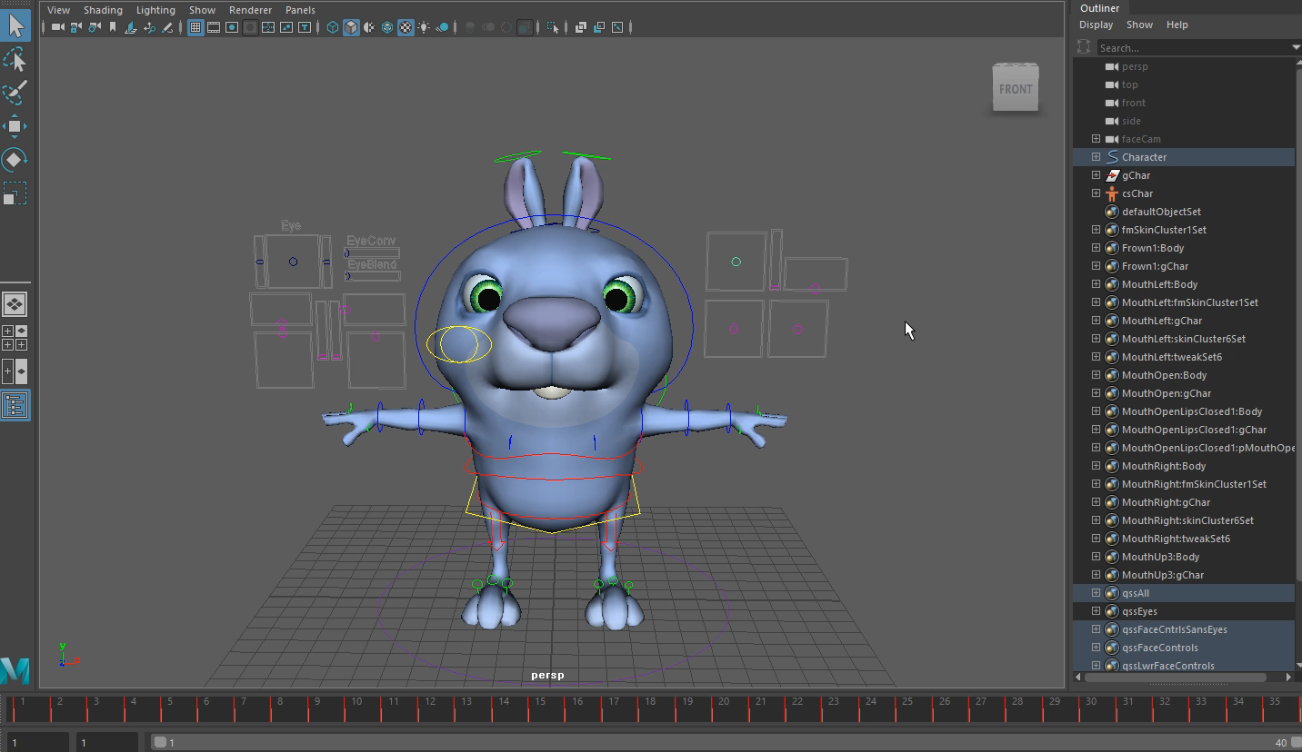
Difficulties
Manual process
Making target ROE data corresponding to the source ROE data one by one
Notes:
In the process of
해당 모델에서 source에 대응되는 표정을 만들 수 없는 경우, 비슷하게 만들기 위해

Slide 17
Thank you for listening!

Slide 18
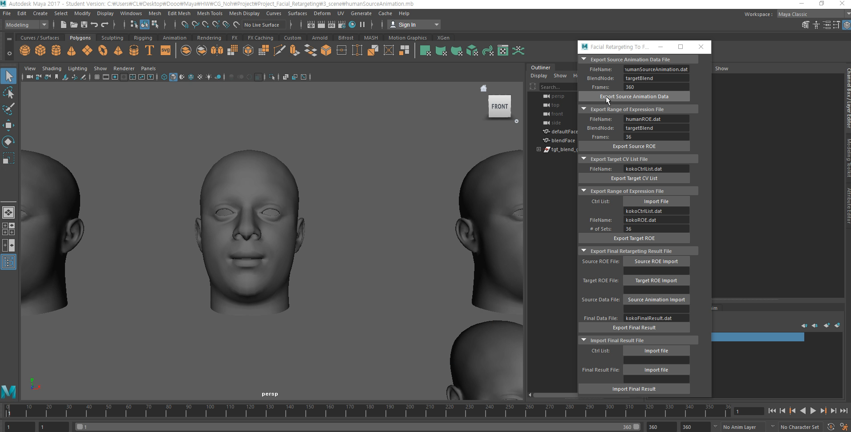

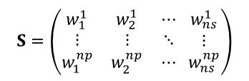
Implement
Export source animation
To make blendshape weights list from source animation
Get blendshape weights at each frames and write down each weight value on the source animation file
$$S=\left(\begin{matrix}w_{1}^{1} & w_{2}^{1} & ⋯ \\ ⋮ & ⋮ & ⋱ \\ w_{1}^{np} & w_{2}^{np} & ⋯\end{matrix} \begin{matrix}w_{ns}^{1} \\ ⋮ \\ w_{ns}^{np}\end{matrix}\right)$$
FRRBlendExport
Notes:
First step is exporting source animation

Slide 19
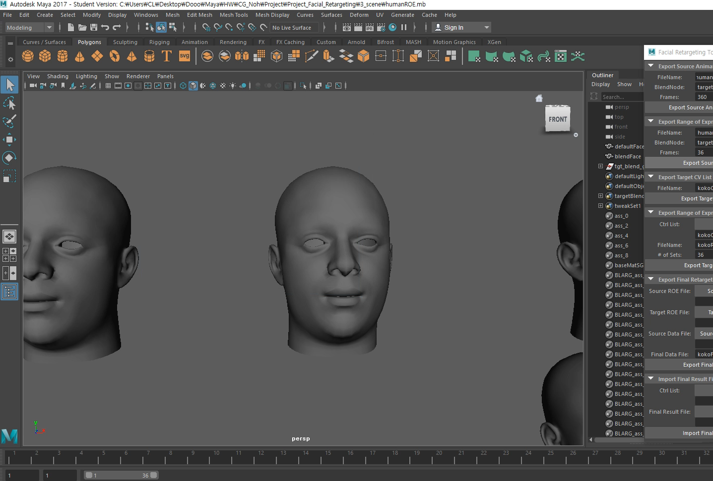
Implement
Export source ROE
To make the ROE list from source character
Get ROE values at each frames and write down each weight value on the source ROE file
FRRBlendExport
Notes:
Exporting source ROE is same as the previous process.

Slide 20
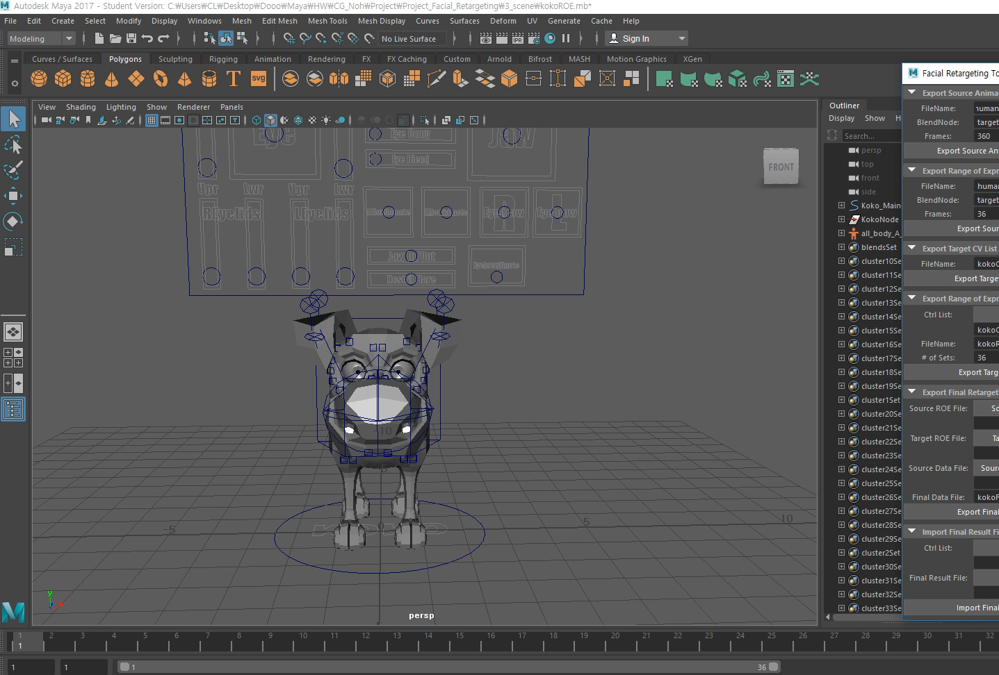
Implement
Export target ROE
To make the ROE list from the target character control list
Get attributes of controllers at each frames and write down each weight value on the source ROE file
FRRCVExport
Notes:
In this stage, the target ROE list is computed for making pairs
By using control vector list data, the attributes of transform are obtained and written to the target ROE file

Slide 21
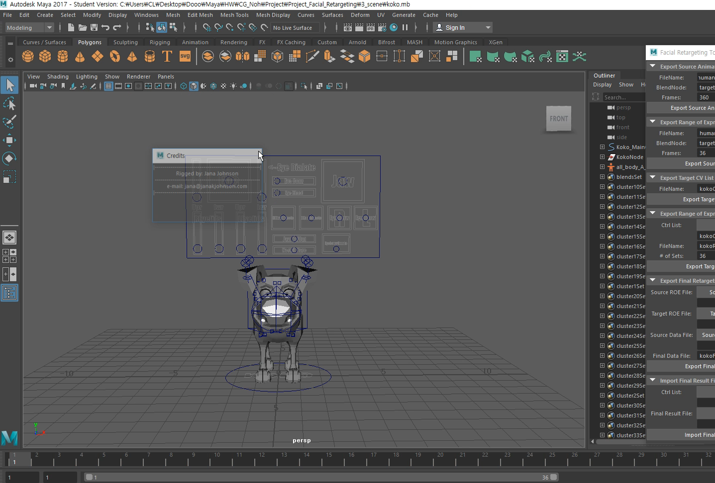
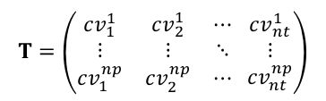
Implement
Export target animation
To make the facial motions of target
Run RBF interpolation
Train the model with source ROE and target ROE → weight matrix
Interpolate source Animation with weight matrix → result matrix for target animation
$$T=\left(\begin{matrix}{cv}_{1}^{1} & {cv}_{2}^{1} & ⋯ \\ ⋮ & ⋮ & ⋱ \\ {cv}_{1}^{np} & {cv}_{2}^{np} & ⋯\end{matrix} \begin{matrix}{cv}_{nt}^{1} \\ ⋮ \\ {cv}_{nt}^{np}\end{matrix}\right)$$
FRRTraining
Notes:
Using the source ROE data, build the basis matrix and invert it.
Then dot product of inverseBasis matrix and target ROE data is performed and put it into the weight matrix.
Dot product of source animation data and weight matrix

Slide 22
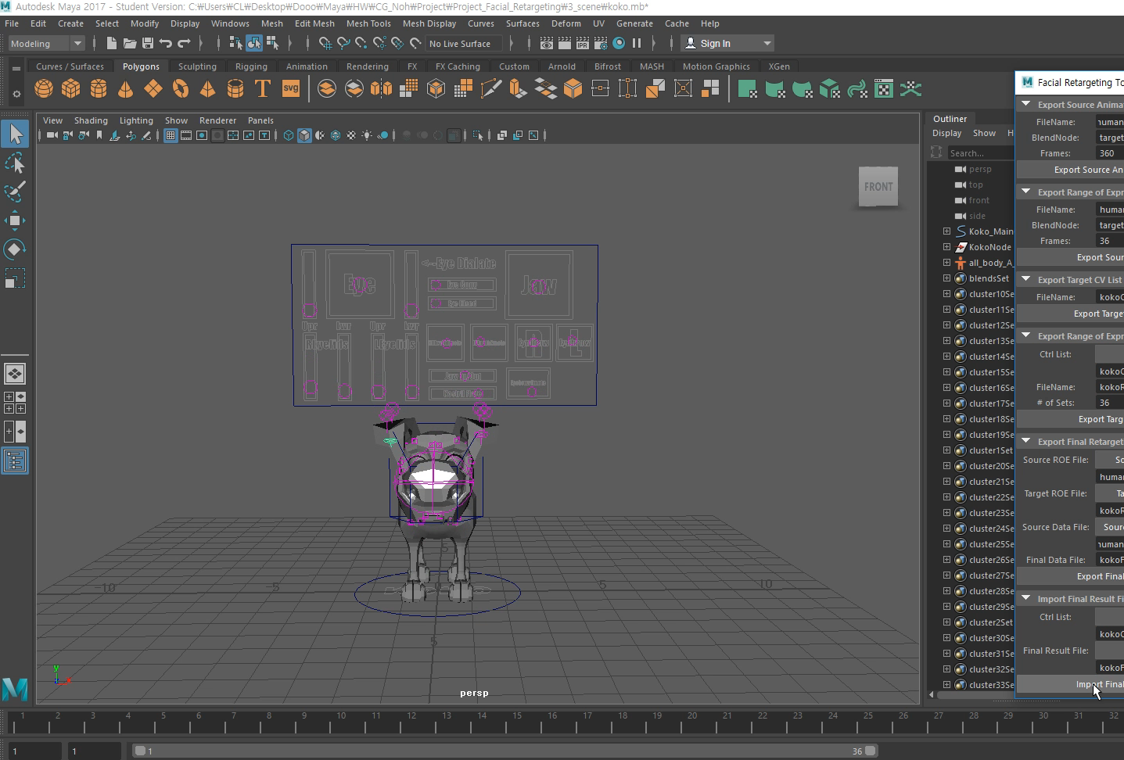
Implement
Import final result
Make the animation of target character corresponding the source animation
Get animation data from final result file and set them in each key frame
FRRCVImport

